Slide 1
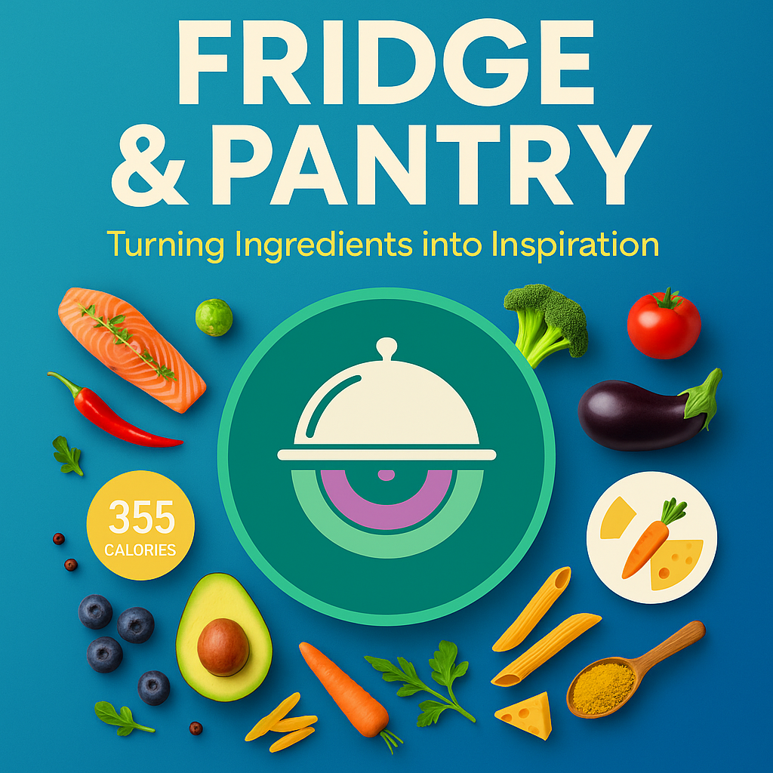
Imagine your kitchen as a DJ's booth, and all your ingredients are like records waiting to be mixed. This app, "Fridge & Pantry DJ," helps us make amazing meals just by using what we already have. No more staring blankly into the fridge, wondering what to cook! It's all about making cooking creative, reducing food waste, and making mealtime fun.

Slide 2
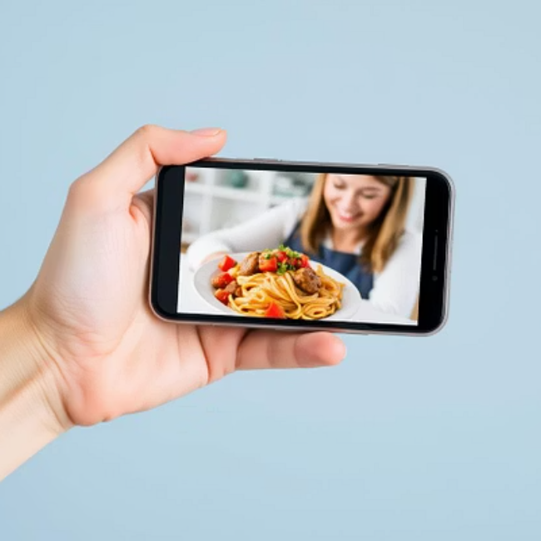
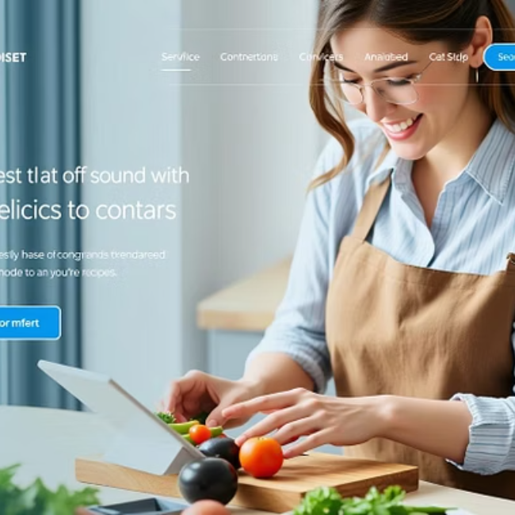
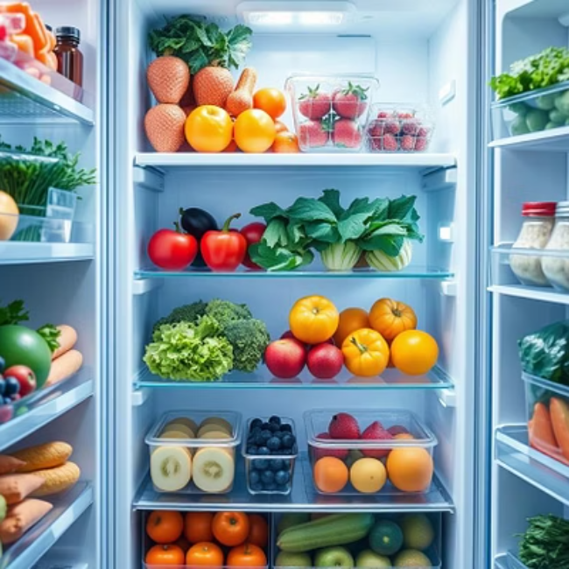
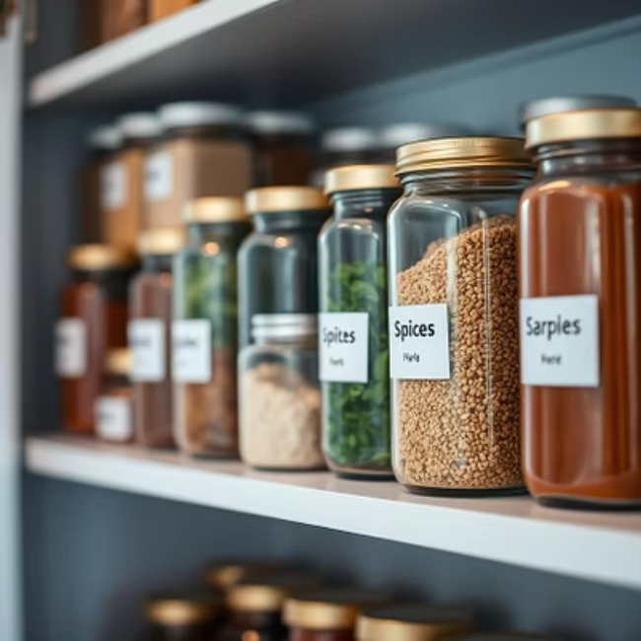

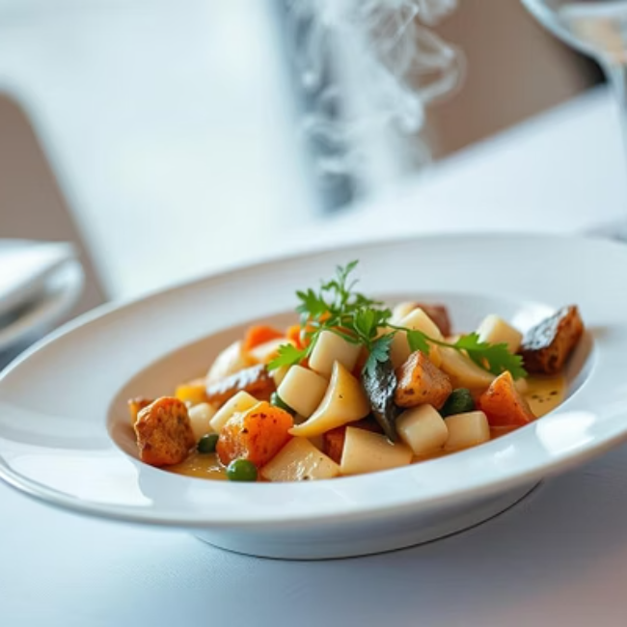
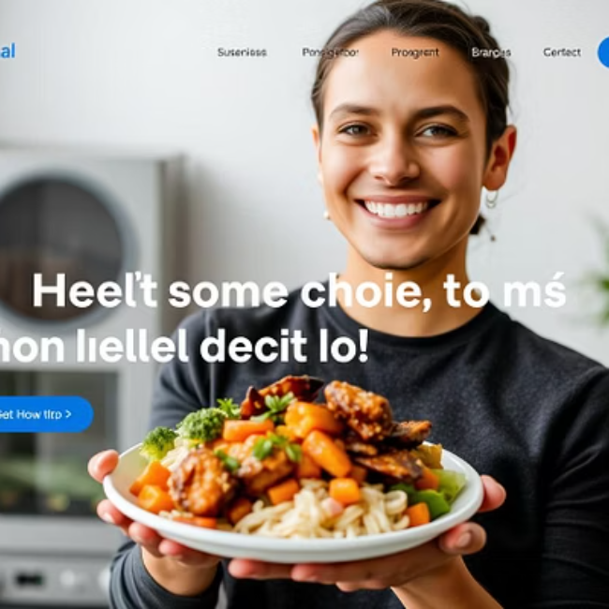
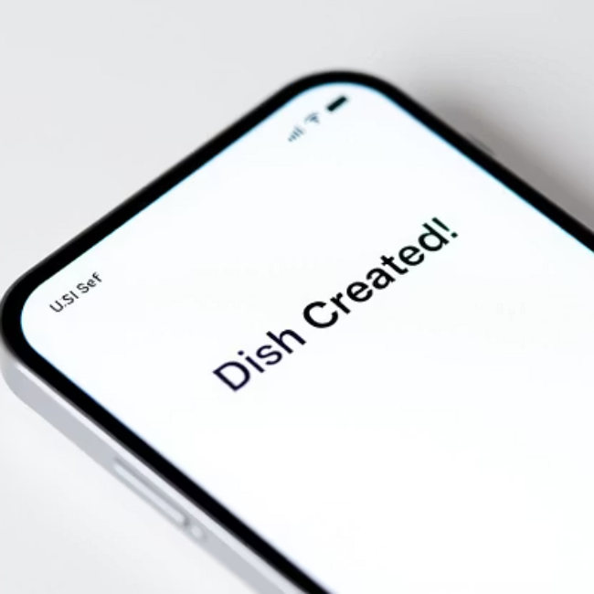
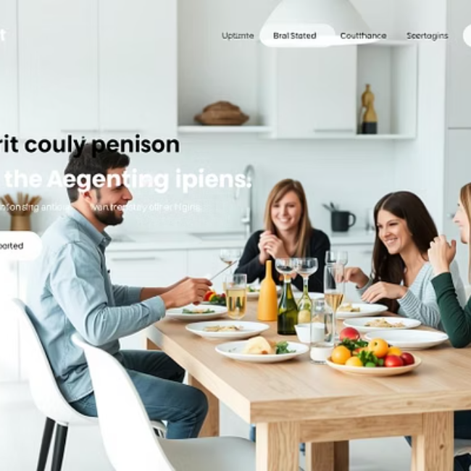
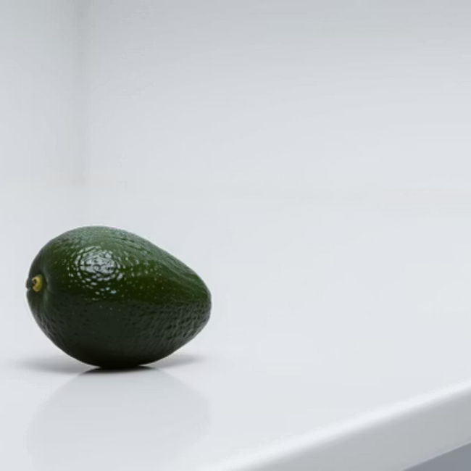
Visual Feast: A Glimpse Inside

Slide 3




Unleash Your Inner Kitchen DJ!
Your Kitchen, Your Stage
Mix & Match Magic
Think of your kitchen as a DJ booth and your ingredients as the records. It's time to create some culinary magic!
This app helps you craft delicious recipes using ingredients you already have, turning forgotten items into spontaneous feasts.
Zero Waste Wonders
Fun & Flavorful
Wave goodbye to food waste! Our app guides you to utilize every last bit, making your cooking more sustainable and resourceful.
Cooking becomes a playful adventure, not a chore. Discover new flavor combinations and express your creativity with every dish.

Slide 4
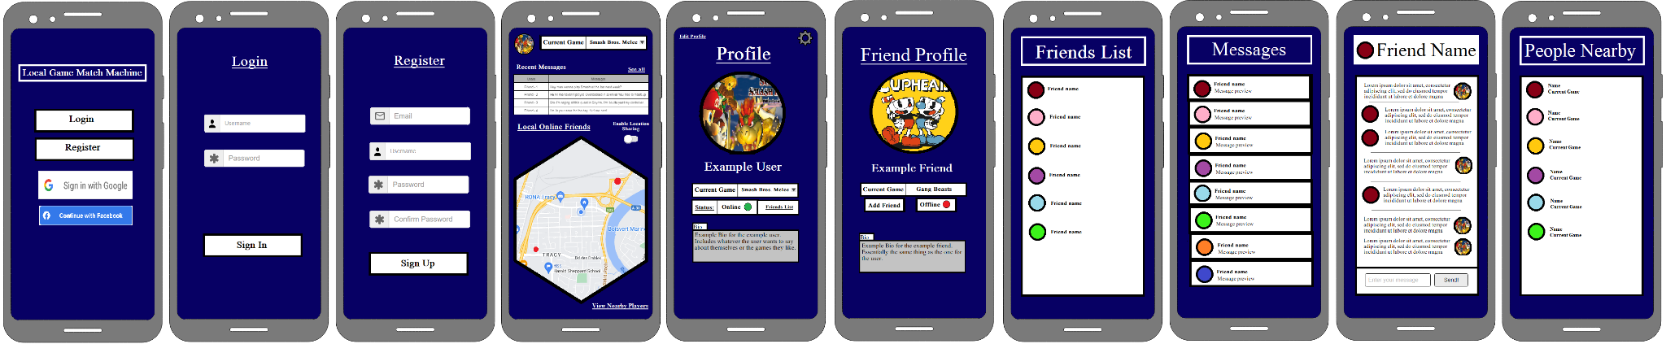
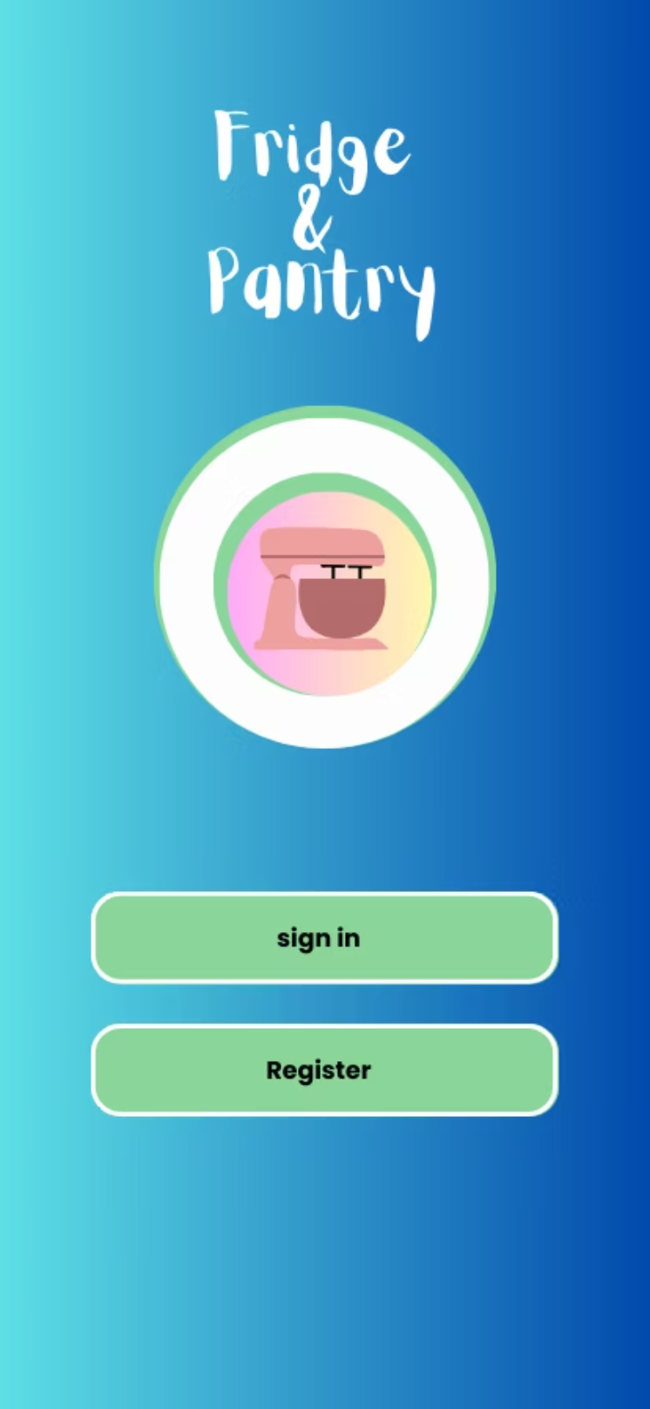
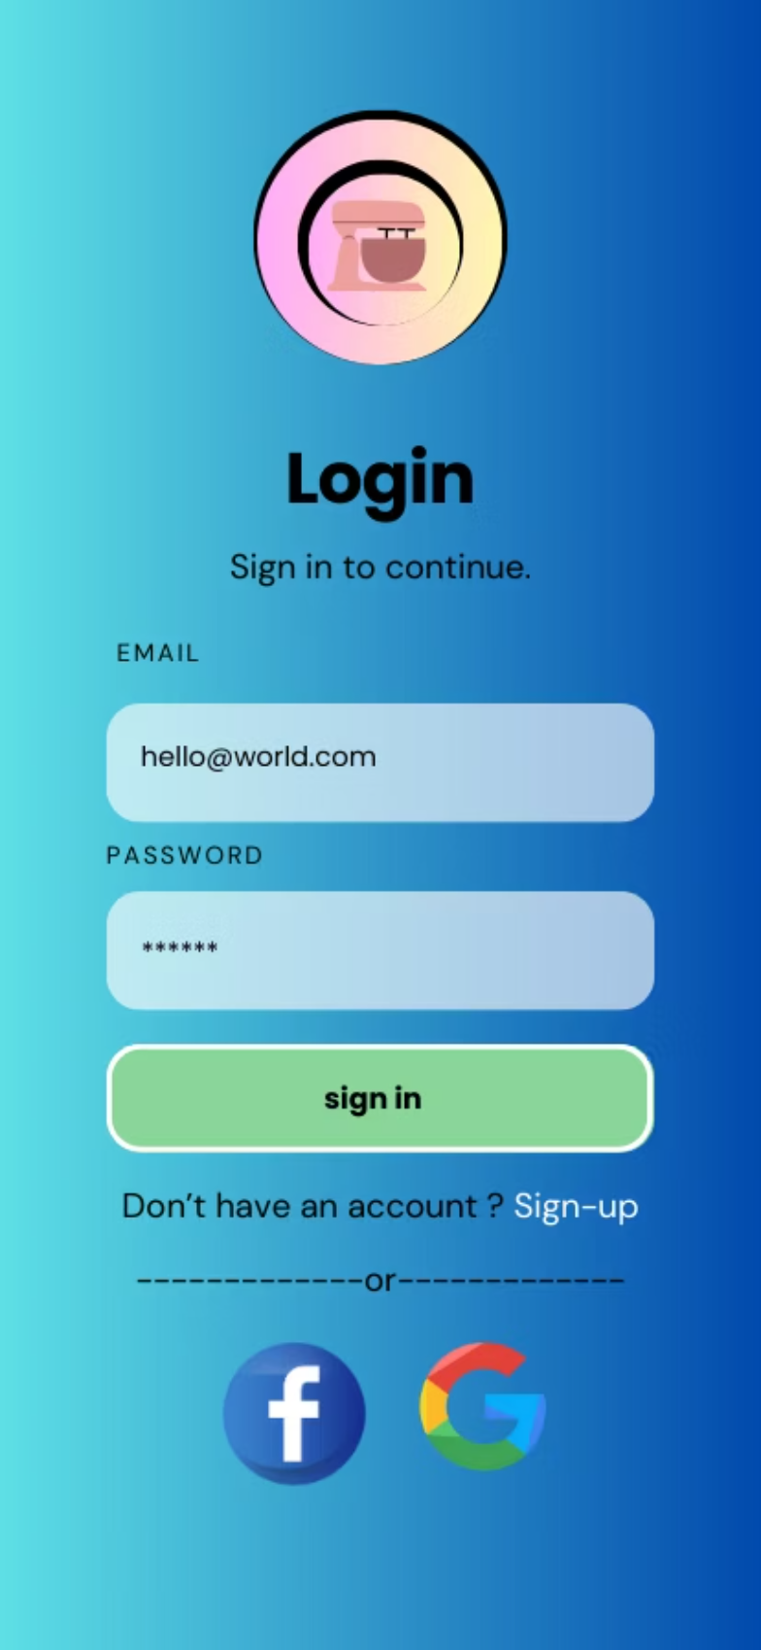
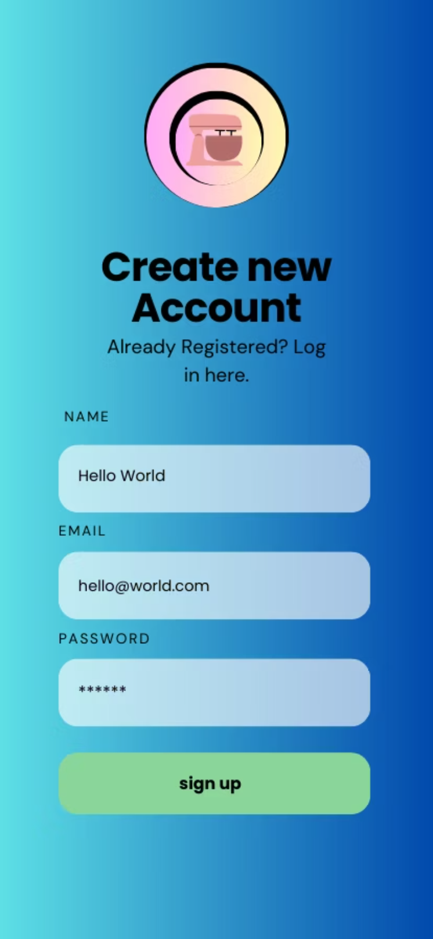
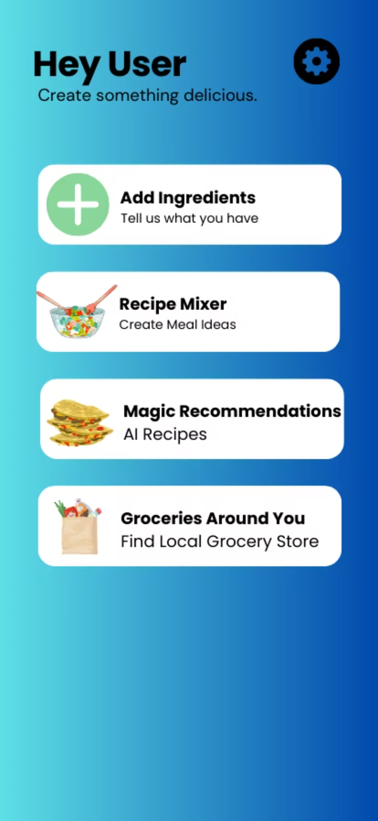
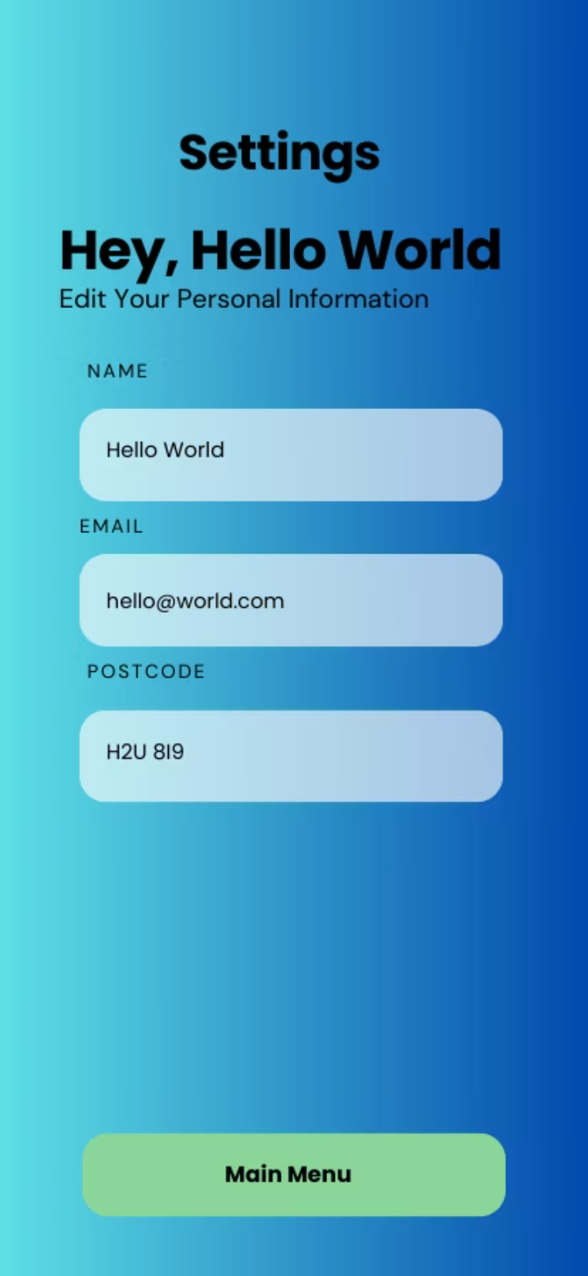
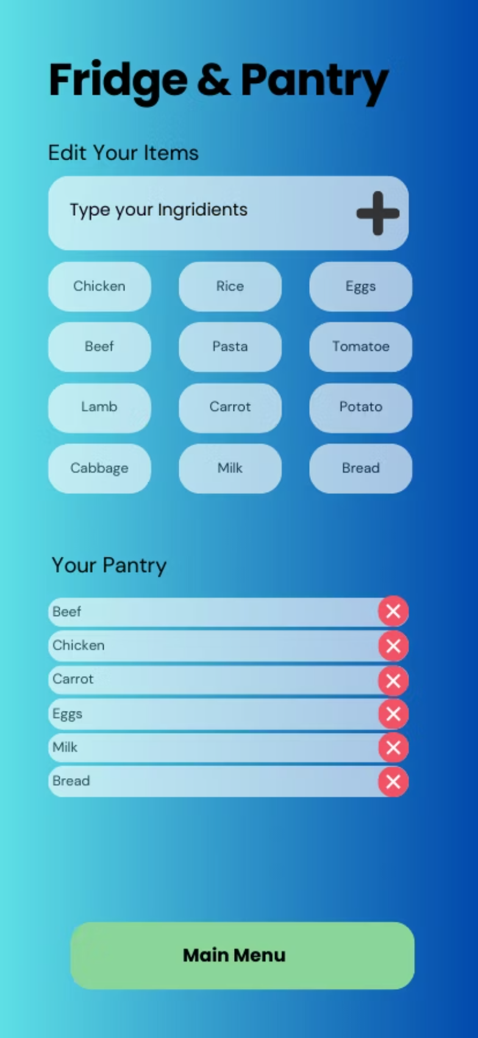
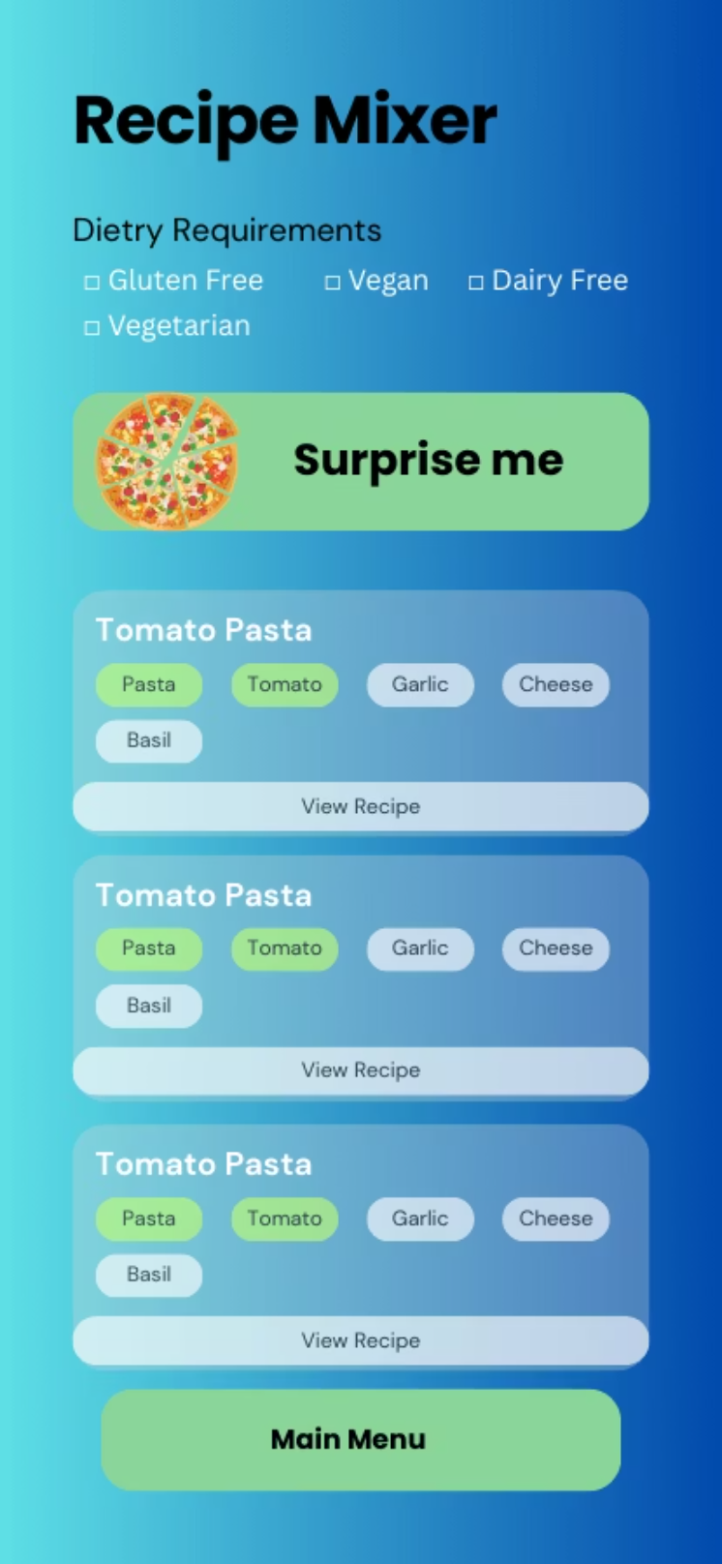
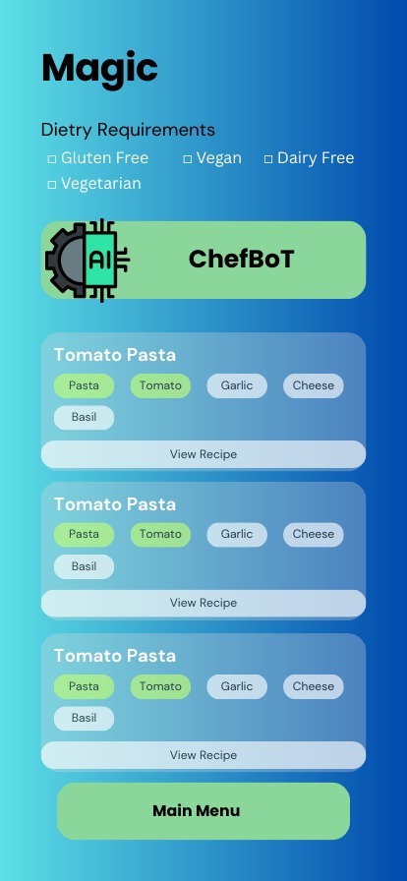
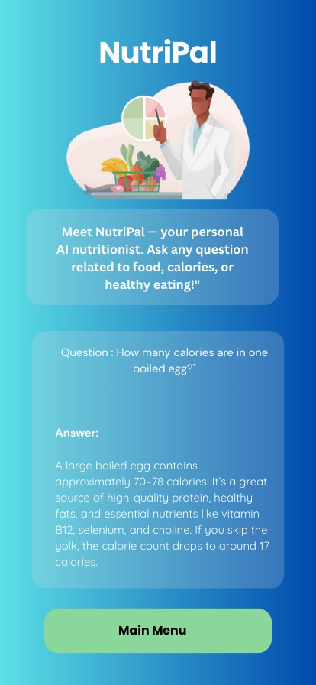
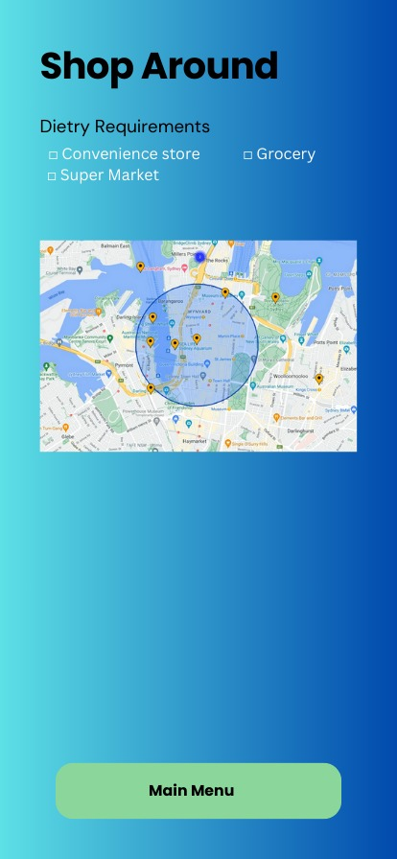
Mock-Up

Slide 5
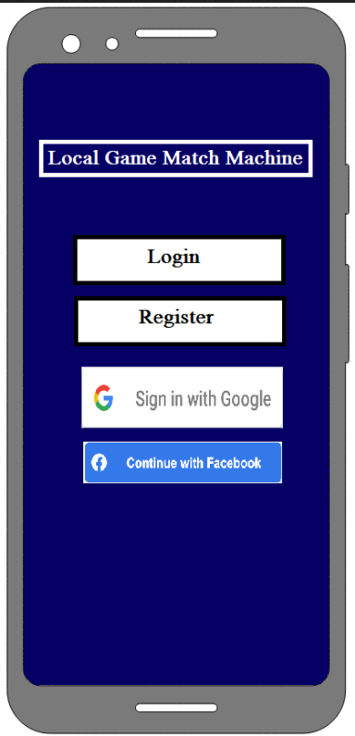
Dive In: The Welcome Screen
Your Culinary Journey Begins!
Get ready to transform your kitchen experience. The Welcome Screen greets you with vibrant visuals and an invitation to explore a world of flavors. It’s the perfect intro to effortless cooking and creative recipe discovery.

Slide 6
Seamless Entry: Login Screen
It allows users to securely sign in using their email and password or log in via Facebook or Google for a faster experience. The screen also provides a direct link to the sign-up page for new users.

Slide 7
Join the Flavor Crew: Register Screen
New users can easily create an account on the sign-up screen by entering their name, email, and password.

Slide 8
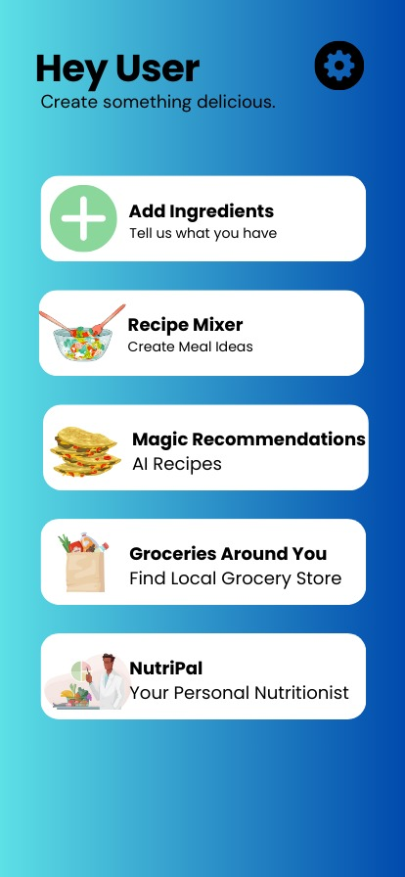
Your Command Center: Main Menu
After logging in, users are greeted with a personalized dashboard designed to kickstart their cooking journey. The screen showcases five key features: Add Ingredients to list what’s available in the kitchen, Recipe Mixer to generate creative meal ideas, Magic Recommendations powered by AI for personalized recipes, Groceries Around You to locate nearby stores, and NutriPal — a smart nutrition assistant to answer questions about healthy eating.

Slide 9
Customize Your Kitchen: Settings
The settings screen enables users to update their personal information, including name, email address, and postal code. This helps personalize the app experience, particularly for features such as locating nearby grocery stores.

Slide 10
Inventory Your Beats: Add Ingredients
Lets users manage their kitchen inventory by adding, editing, or removing ingredients from their pantry. Users can select common items or type in custom ingredients to build their list.

Slide 11
The Ultimate Mashup: Recipe Mixer
The Recipe Mixer screen helps users generate creative meal ideas using ingredients they already have. Users can filter results based on dietary preferences like gluten-free, vegan, or vegetarian. The fun “Surprise Me” button adds spontaneity, offering randomized recipe suggestions. Each result shows matching ingredients with a quick link to view full instructions, making it easier than ever to cook something delicious with minimal effort.

Slide 12
Magic Recommendations - ChefBot
ChefBoT, an AI-powered assistant that generates personalized recipe suggestions based on the ingredients in your pantry and your dietary preferences. Whether you’re vegan, gluten-free, or just curious, ChefBoT delivers intelligent, tailored meal ideas in seconds.

Slide 13
NutriPal – AI Nutrition Assistant
NutriPal is your personal AI-powered nutritionist, ready to answer any question about food, calories, or healthy eating. Whether you're curious about the nutritional value of ingredients or looking for diet tips, NutriPal provides instant, informative responses to help users make healthier choices. It’s a smart, supportive feature that brings nutrition advice right to your fingertips.

Slide 14
Shop Around Screen
Helps users locate nearby grocery stores, supermarkets, or convenience stores based on their selected preferences. With an interactive map and filtering options, users can easily find the closest places to restock their ingredients.

Slide 15
Other Information
Number of screen flows: 10 screens
Chosen Database: Firebase
GitHub Repository: Fridge & Pantry DJ Project
Group Members: Rishard, Melissa, and Manar

